Slide 1

Data Analytics Process
Application in Real-life Scenario
Pratham barot

Slide 2
Data Analytics
Data Analytics is the process of collecting, cleaning, transforming, and organizing data in order to draw conclusions, make predictions, and help in decision making.
Data analytics help businesses operate more effectively and enhance productivity in today’s world.
Data analytics used in different industries like Healthcare, Banking, Security, Ecommerce, Manufacturing, Science and Technologies.
Data is everywhere and we use Data Analytics in everyday life without even knowing it.

Slide 3
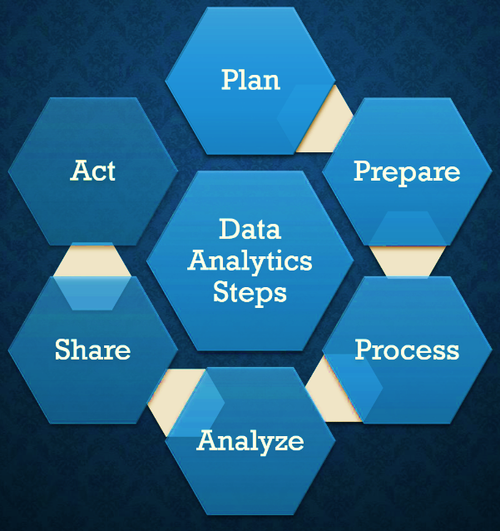


Slide 4
Real life Scenario: Going to a mall to buy Apparel
1. Plan
1
Decide a mall to go shopping
2
Identify what specific clothing items needed
3
Make a list like shirts, jeans, formal clothing, etc.

Slide 5
2. Prepare
1
Setting a budget to spend on apparel
2
Style Preferences considering current trends
3
This will help me narrow down the options

Slide 6
3. Process
1
Research current fashion trends to get an idea
2
Store selection based on budget
3
For instance, a high-end store for formal wear and a budget-friendly store for casual wear

Slide 7
4. Analyze
1
In-store camparison like asses their fit, comfortability, prices between brands
2
Trend Analysis where apparel is versatile and trendy enough to wore
3
Buying matching outfits for multiple occasion

Slide 8
5. Share
Seeking opinions from sale associates or family members about the items you are considering.
Communicating my idea to shopkeeper finding the best suitable fit for me.

Slide 9
6. Act
I will finally buy it.

Slide 10
Thank You

